Slide 1

A Hybrid Bollywood Recommendation System
Team :
16010120013 ROHAN D’SOUZA
16010120015 YASH GAVADE
Supervised by :- Prof. Ninad Mehendale

Slide 2

What is machine learning?
Machine learning is a branch of artificial intelligence (AI) and computer science which focuses on the use of data and algorithms to imitate the way that humans learn, gradually improving its accuracy.Machine learning is an important component of the growing field of data science. Through the use of statistical methods, algorithms are trained to make classifications or predictions, uncovering key insights within data mining projects.
These insights subsequently drive decision making within applications and businesses, ideally impacting key growth metrics. As big data continues to expand and grow, the market demand for data scientists will increase, requiring them to assist in the identification of the most relevant business questions and subsequently the data to answer them.

Slide 3

Why Machine Learning?
Machine learning is important because it gives enterprises a view of trends in customer behaviour and operational business patterns, as well as supports the development of new products. Many of today's leading companies, such as Facebook, Google, and Uber, make machine learning a central part of their operations.

Slide 4
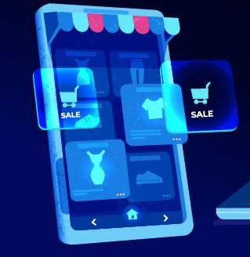
Why Hybrid Recommendation System?
Recommender system has the ability to predict whether a particular user would prefer an item or not .
Recommender systems are beneficial to both service providers and users .
They reduce Time of finding and selecting items in an online environment.
The number of users typically increases when a recommendation system is used.

Slide 5
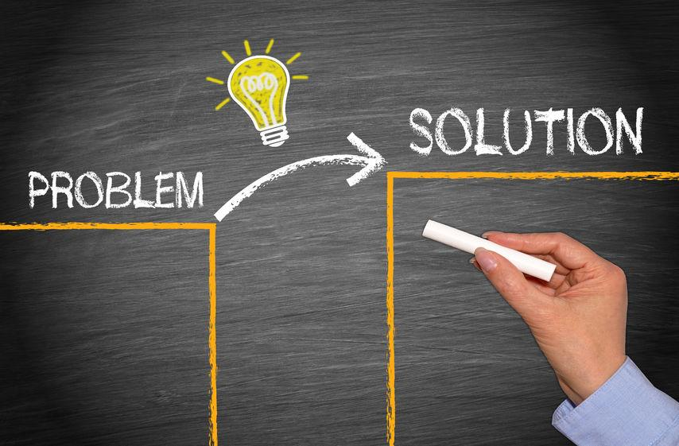
Problem Definition
The amount of information generated by the internet is growing at an overwhelming rate. Businesses are forced to come up with smarter solutions to prevent consumers from being confused by seemingly countless choices and more importantly to be still relevant to them by directing their attention to movies they might be interested in.
Recommendation systems are introduced to e-commerce to help businesses , tackle the challenge.
Movie recommendation system will provide relevant options to the consumers instantly.

Slide 6
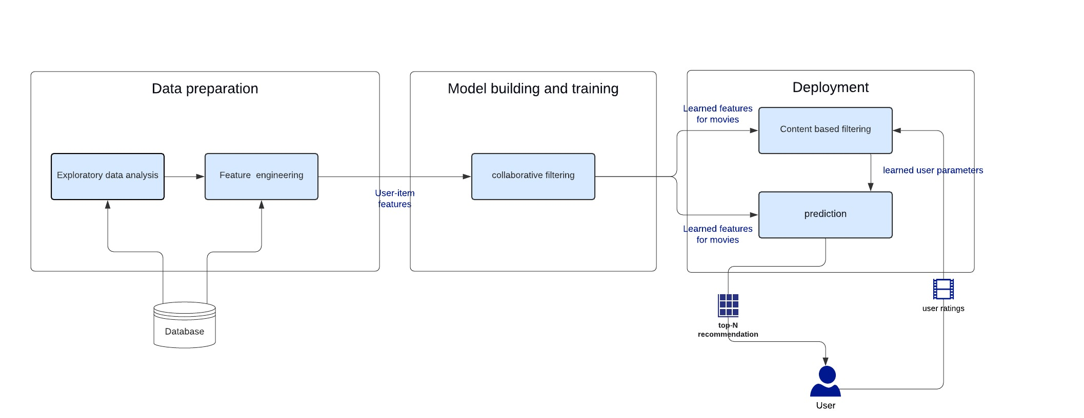
System Architecture

Slide 7

Flow Of Execution
Retrive Data from the Url
Process the Data
Call Function to solve the prob
Display the Solution on Backend
Create the flask website
Process the Data
Solve the highest feature weight
Display the Solution on Website

Slide 8

Why API ?
An API is an abstraction of the web server.
APIs sit between the application and the web server.
The user initiates an API call that tells the application to do something, then the application will use an API to ask the web server to do something.
API helps developers quickly deliver information to consumers.

Slide 9

How do we Recommend the Movies?

Slide 10
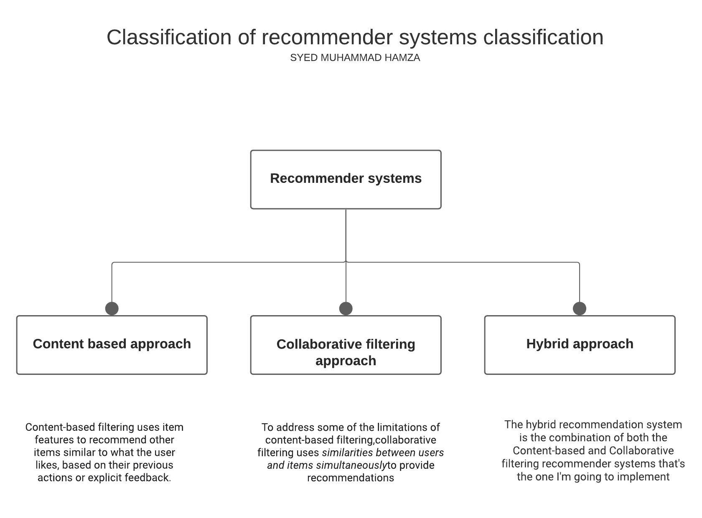
Ways of Recommendation
1)Survey’s filled out by past users for the use of new users
2)Search-style Algorithms
3)Genre matching
4)Past purchase querying

Slide 11

Why Hybrid Based Filtering ?
A Hybrid based recommender works with data that the user provides, either explicitly movie ratings for the Movie dataset.
Based on that data, a user profile is generated, which is then used to make suggestions to the user. As the user provides more inputs or takes actions on the recommendations, the engine becomes more and more accurate.

Slide 12
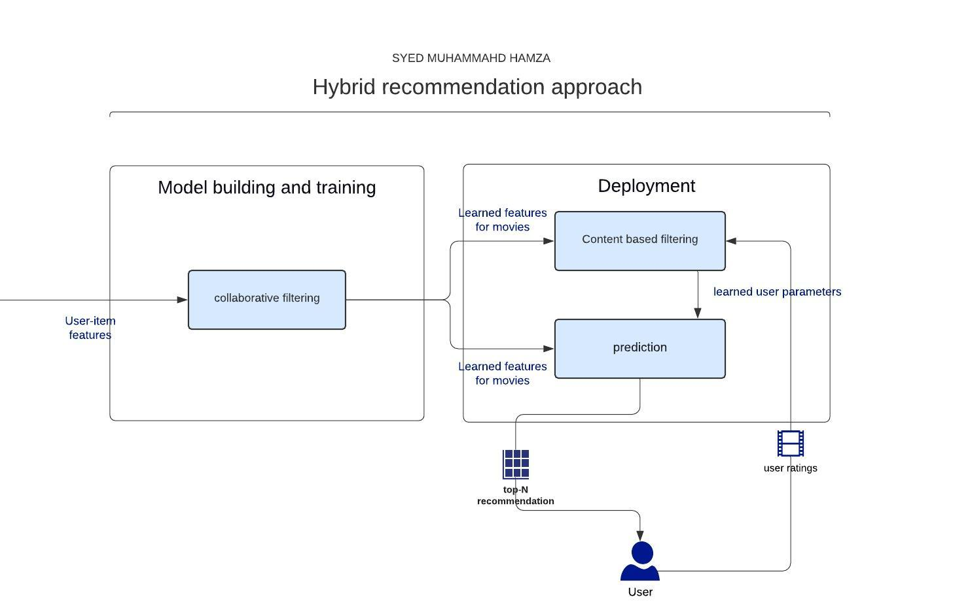
Approach
A hybrid recommendation system is a special type of recommendation system which can be considered as the combination of the content and collaborative filtering method. Combining collaborative and content-based filtering together may help in overcoming the shortcoming we are facing at using them separately and also can be more effective in some cases. Hybrid recommender system approaches can be implemented in various ways like by using content and collaborative-based methods to generate predictions separately and then combining the prediction or we can just add the capabilities of collaborative-based methods to a content-based approach (and vice versa).
Identify users in U similar to u, and extrapolate from their ratings of i.
Generate a classifier that fits u’s rating behavior and use it on i.
Infer a match between i and u’s need

Slide 13

What is Cost-function?
The cost function is defined as the measurement of difference or error between actual values and expected values at the current position and present in the form of a single real number. It helps to increase and improve machine learning efficiency by providing feedback to this model so that it can minimize error and find the local or global minimum.

Slide 14
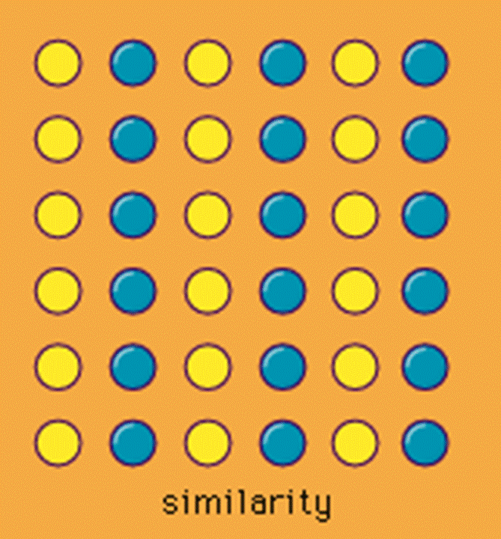
What is Cosine-Similarity?
Cosine similarity is a metric used to measure how similar two or more attributes are irrespective of their size. Mathematically, it measures the cosine of the angle between two vectors projected in a multi-dimensional space. The cosine similarity is advantageous because even if the two similar attributes are far apart by the Euclidean distance (due to the size of the document), chances are they may still be oriented closer together. The smaller the angle, higher the cosine similarity.

Slide 15

Gradient Descent:
Gradient Descent is known as one of the most commonly used optimization algorithms to train machine learning models by means of minimizing errors between actual and expected results, It helps in finding the local minimum of a function.
If we move towards a negative gradient or away from the gradient of the function at the current point, it will give the local minimum of that function.
Whenever we move towards a positive gradient or towards the gradient of the function at the current point, we will get the local maximum of that function.

Slide 16
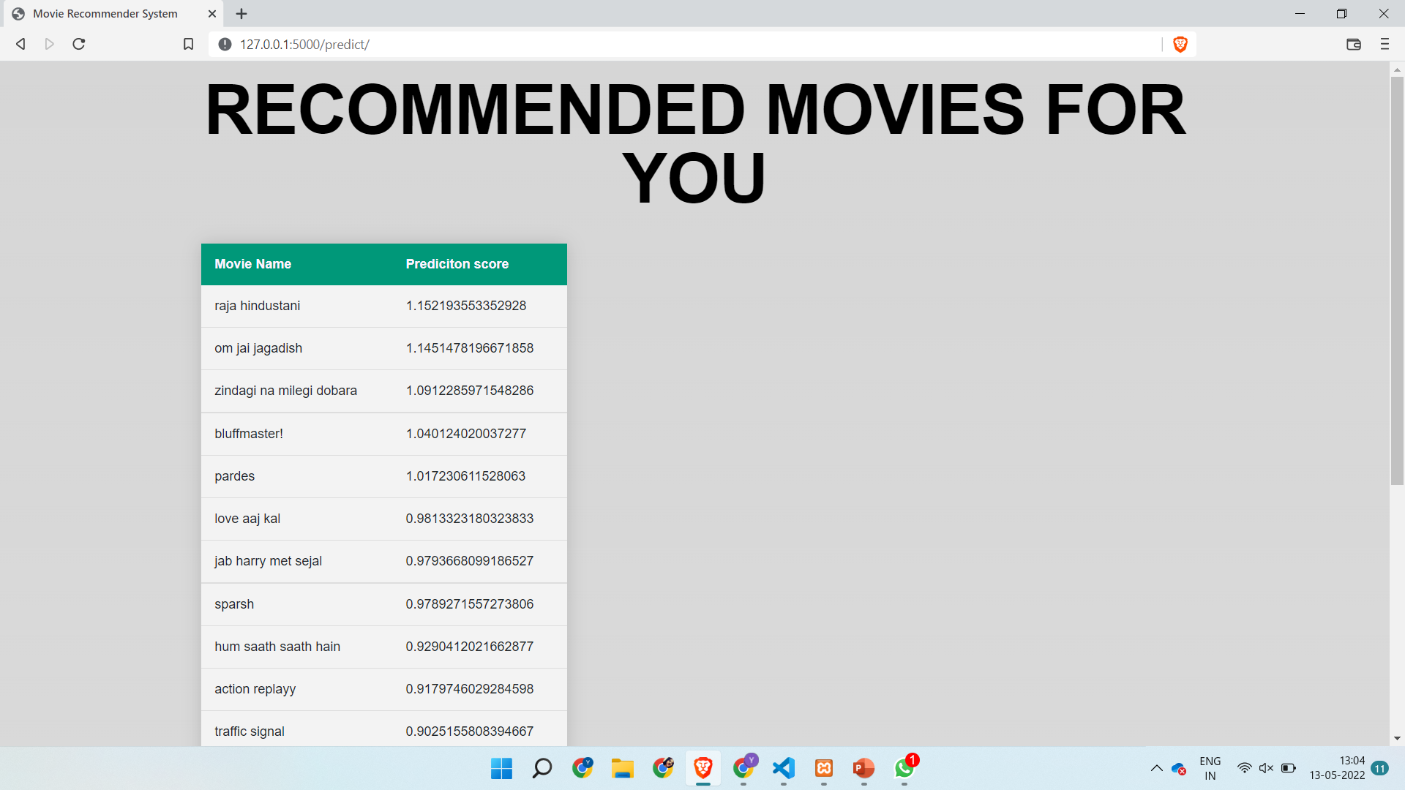
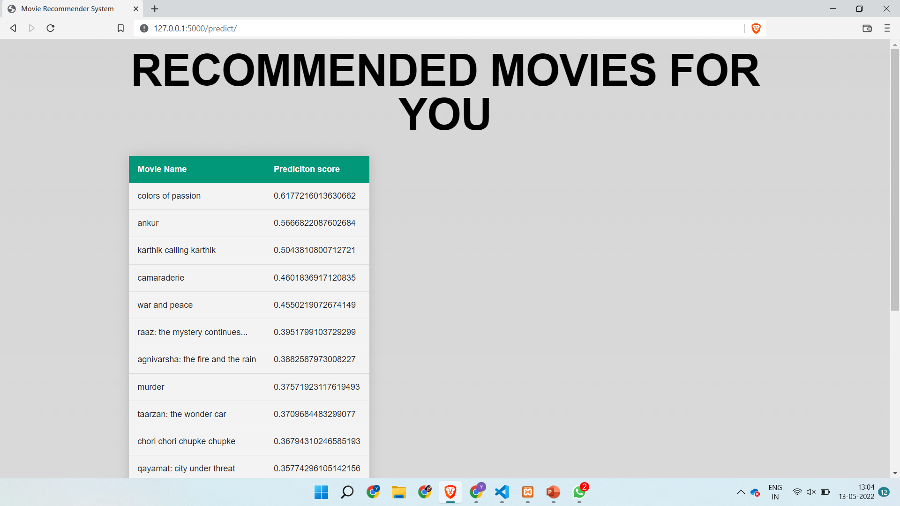
Output of Movie recommendation
output
output

Slide 17

1) app.py
A) Content Recommendation
B) Collaborative Recommendation:
C) Hybrid Recommendation
Modules that are used

Slide 18

Future Scope
Recommender systems can be a very powerful tool in a company’s brand image , and future developments are going to increase business value even further.
Some of the applications include being able to anticipate seasonal purchases based on recommendations, determine important purchases, and give better recommendations to customers which can increase retention and brand loyalty.
Most businesses will use Recommendation system in future as it will increase the value of the product .
Recommender systems will be used in the future to predict demand for products, enabling earlier communication back the supply chain.

Slide 19
Conclusion
we have introduced Hybrid Movie Recommendation system , a recommender system for movies.
It allows a user to select his choices from a given set of attributes and then recommend him a movie list based on the cumulative weight of different attributes.
By the nature of our system, it is not an easy task to evaluate the performance since there is no right or wrong recommendation; it is just a matter of opinions. Based on informal evaluations that we carried out over a small set of movie data set .
We would like to work on a larger data set which will enable more meaningful results using our system.

Slide 20
References
[1]. [H. Zhang, F. Min, D. Ślęzak and B. Shi, "Cost-sensitive regression-based recommender system," 2015 International Conference on Machine Learning and Cybernetics (ICMLC), 2015, pp. 253-258, doi: 10.1109/ICMLC.2015.7340931.](https://ieeexplore.ieee.org/document/7340931)
<br/>
[2]. [G. Lekakos and P. Caravelas, "A hybrid approach for movie recommendation", Multimedia tools and applications, vol. 36, no. 1–2, pp. 55-70, 2008.
updting soon]()
<br/>
[3]. [P. Cremonesi, R. Turrin and F. Airoldi, "Hybrid algorithms for recommending new items", Proceedings of the 2nd International Workshop on Information Heterogeneity and Fusion in Recommender Systems, pp. 33-40, 2011.](https://dl.acm.org/doi/10.1145/2039320.2039325)
.

Slide 21


